Slide 1

Beam Deflection Simulation
Notes:
Beam Deflection Simulation

Slide 2
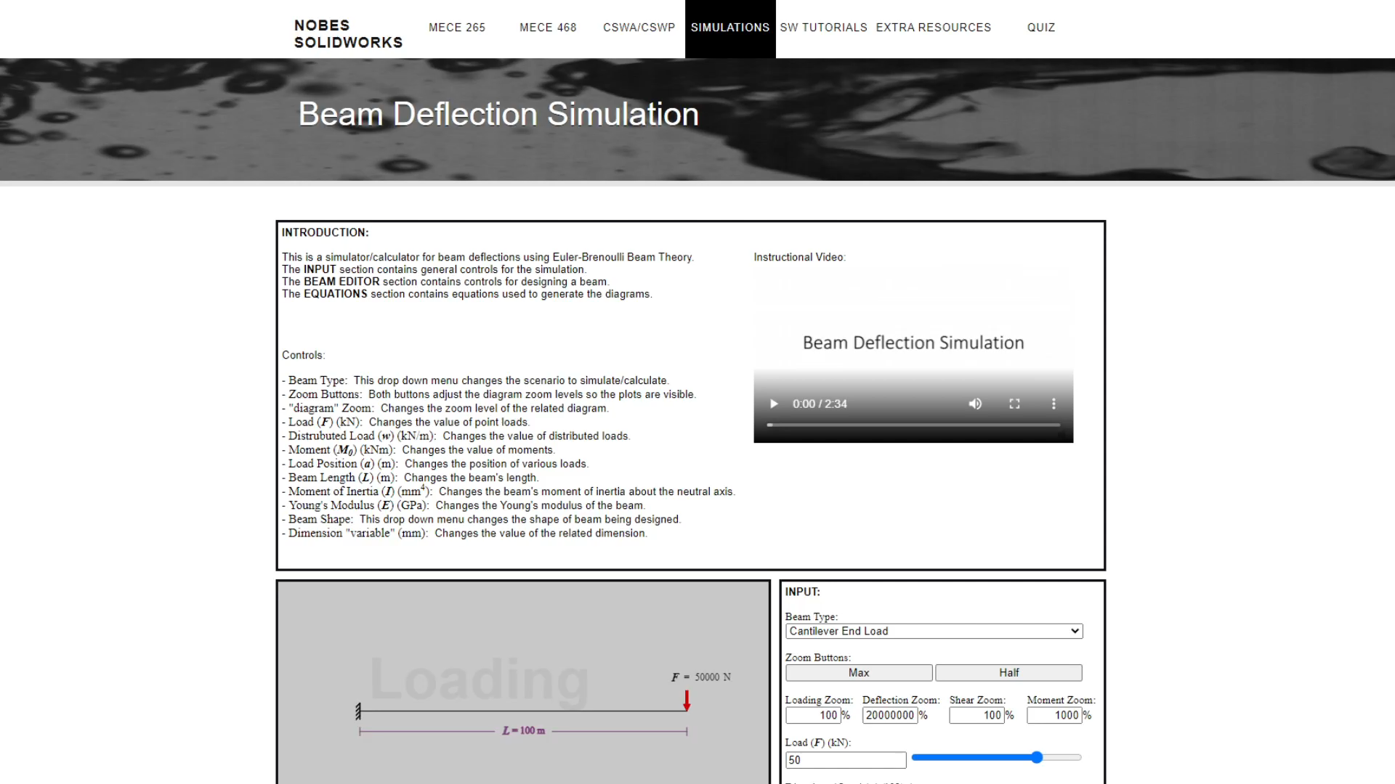
Introduction
Notes:
In engineering, beam deflection is a fundamental concept, but students may find it difficult to visualize. The goal of this simulation is to help students visualize how different variables affect deflection, shear, and bending moment diagrams for different beam-deflection-scenarios.

Slide 3
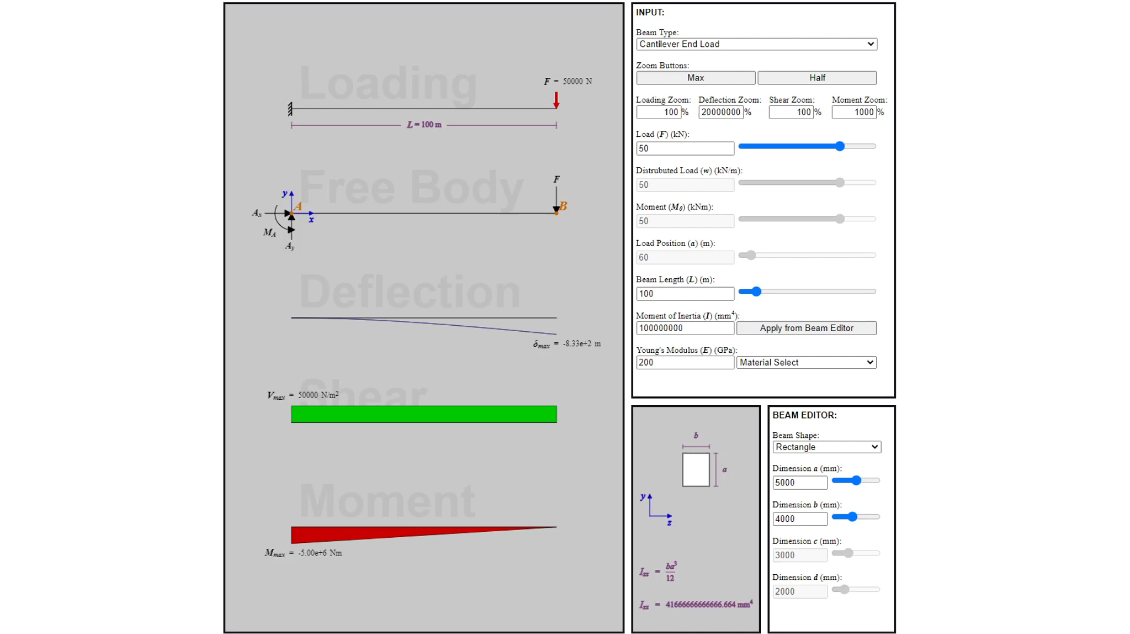
Controls
Notes:
Controls. The diagrams are controlled with the interactive elements in the section titled “input”. At the top, the “beam type” drop-down-menu changes the beam-deflection-scenario simulated by the diagrams. The “zoom” buttons adjust the scale of the diagrams so their plots are clearly visible, and the “zoom” text-boxes control the scale of the diagrams individually. The diagrams have upper and lower limits, and they automatically zoom-out when their plots are too big to be displayed. Next are the controls for each variable. Most variables are adjusted with text-boxes and sliders. Moment-of-inertia and Young’s-modulus can both be adjusted with text-boxes, but they can also be adjusted with a button and drop-down-menu respectively. The Young’s-modulus drop-down-menu, applies the Young’s-modulus of the selected material. The moment-of-inertia button applies the moment-of-inertia from the “Beam Editor”.

Slide 4
Beam Editor
Notes:
Beam Editor. The “beam editor” is used to design a beam and apply its moment-of-inertia to the rest of the simulation. The moment-of-inertia of the designed beam can be applied with the “Apply from Beam Editor” button in the section titled “input”. The “beam editor” has its own set of controls. At the top, the “beam shape” drop-down-menu changes the shape of the beam. All the variables can be adjusted with text-boxes and sliders.

Slide 5
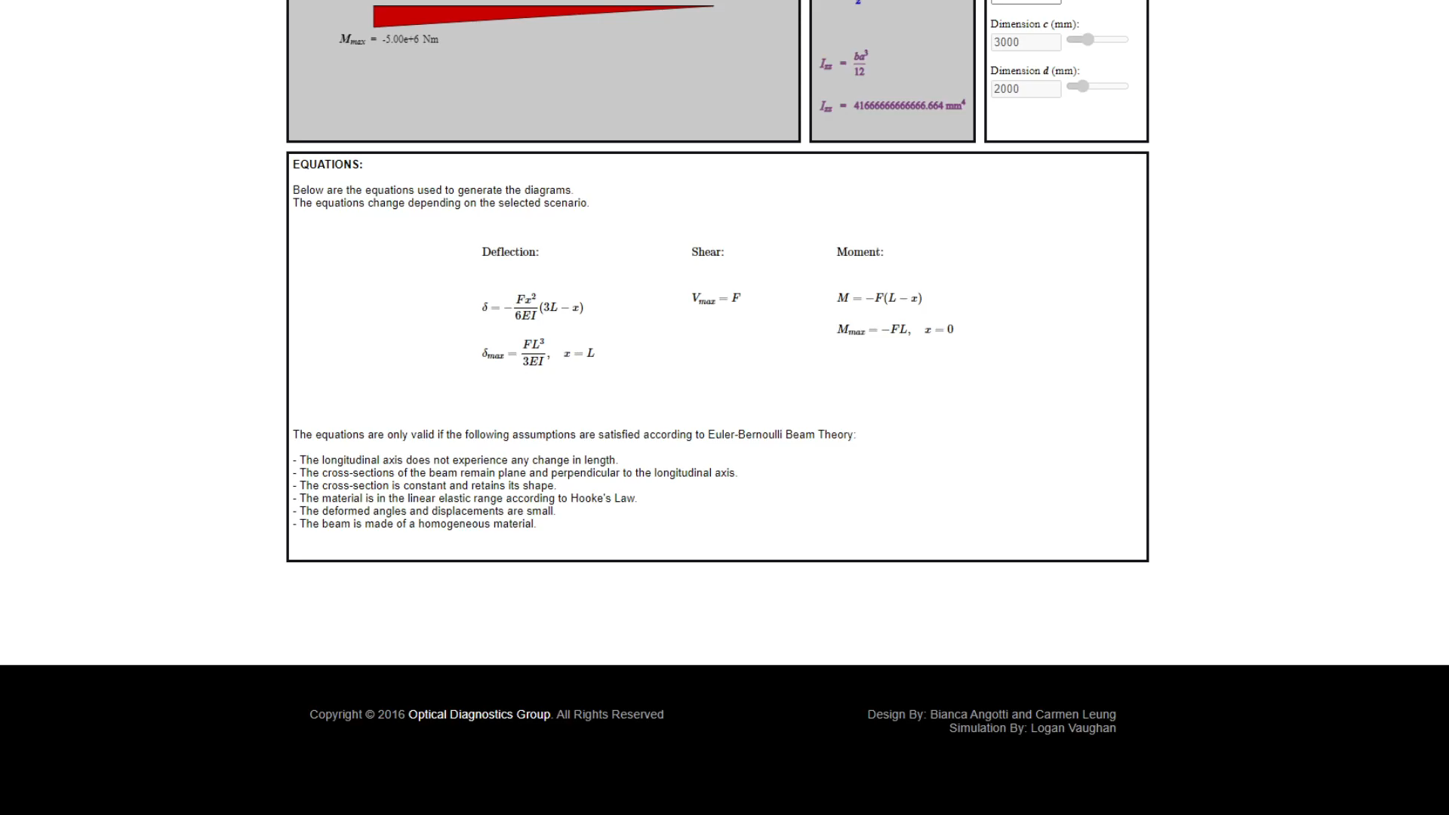
Calculations
Notes:
Calculations. The equations that are used to plot the diagrams for the selected beam-deflection-scenario are displayed in the section titled “equations”. These equations will change whenever another beam-deflection-scenario is selected. The box titled “equations” also contains a list of assumptions that must be satisfied if the equations, and, therefore, the simulation itself, is to be considered valid.

Slide 6
Conclusion
Notes:
Play around with the simulation and familiarize yourself with the equations to further your understanding of beam deflection, and the relating deflection, shear, and moment diagrams.

